Slide 1

Porsche 911 GT3 RS: The Ultimate Track-Ready Machine
A focused, road‑legal race car engineered to deliver uncompromising lap times and exhilarating driver engagement. This presentation breaks down the GT3 RS’s key specs: powertrain, performance, aero, chassis, tires, dimensions, efficiency, and ownership essentials.

Slide 2
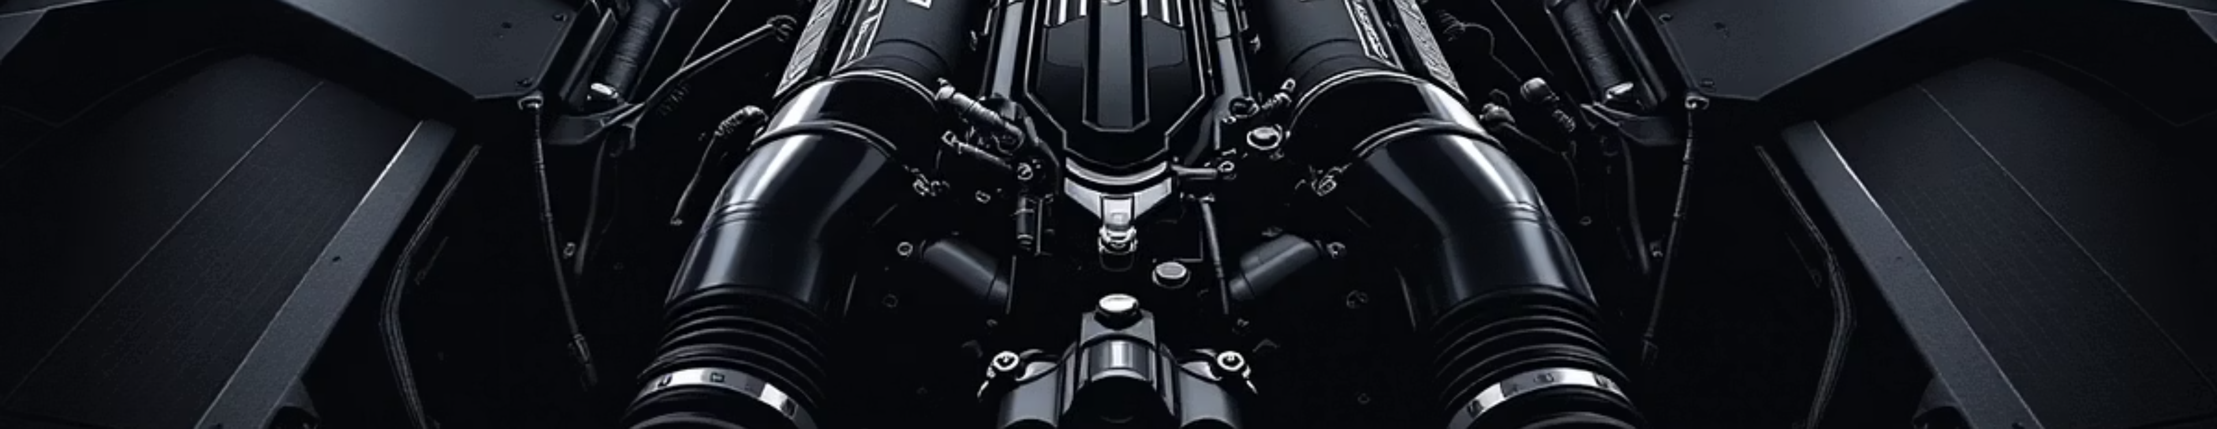
Heart of a Legend: Engine & Powertrain
Powerplant
Output
Transmission & Drive
4.0‑liter naturally aspirated flat‑six optimized for peak power at high rpm.
525 hp @ 8,400 rpm and 465 Nm (343 lb‑ft) torque — instant throttle response, linear power delivery.
7-speed Porsche Doppelkupplung (PDK) dual‑clutch gearbox. Rear‑wheel drive for pure, tactile dynamics.

Slide 3
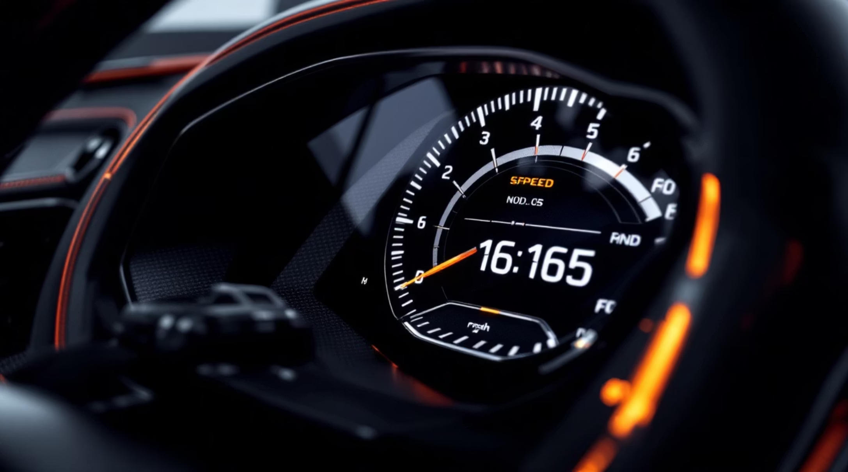
Lightning Fast: Acceleration & Top Speed
0–60 mph: 3.0 seconds — explosive off the line thanks to power-to-weight tuning and rapid PDK shifts.
Top Speed: 184 mph (296 km/h) — balanced for high-speed stability with aerodynamic support.
Curb Weight: ~3,131 lbs (1,420 kg) — lightweight construction for razor‑sharp agility.

Slide 4


Aerodynamics Mastery
Massive Downforce
Generates 901 lbs of downforce at 124 mph — roughly double the prior generation to improve cornering grip.
Active Aero
Front diffuser, adjustable rear wing and flaps for optimized balance across speed ranges.
DRS Technology
First road‑legal Porsche with Drag Reduction System for reduced drag on straights and quicker lap times.

Slide 5
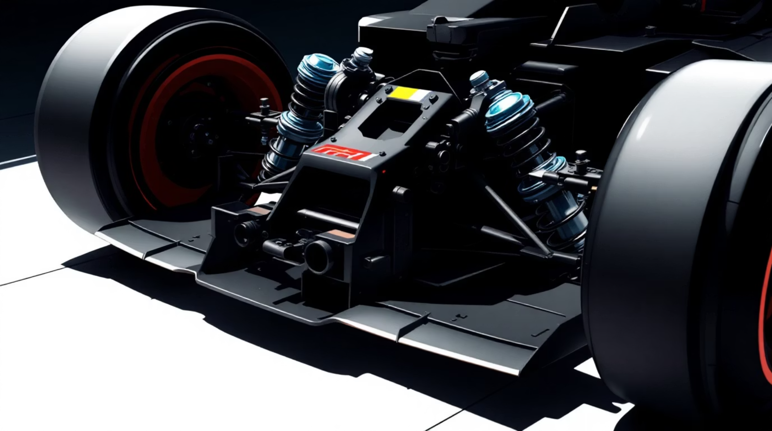
Precision Engineering: Chassis & Suspension
Structure: Monocoque combining high‑strength steel and aluminum for torsional rigidity with minimal weight.
Suspension: Front MacPherson strut with race-inspired geometry and multi‑link rear for rear traction and stability.
Steering: Variable‑ratio power steering delivering precise, communicative feedback at all speeds.

Slide 6
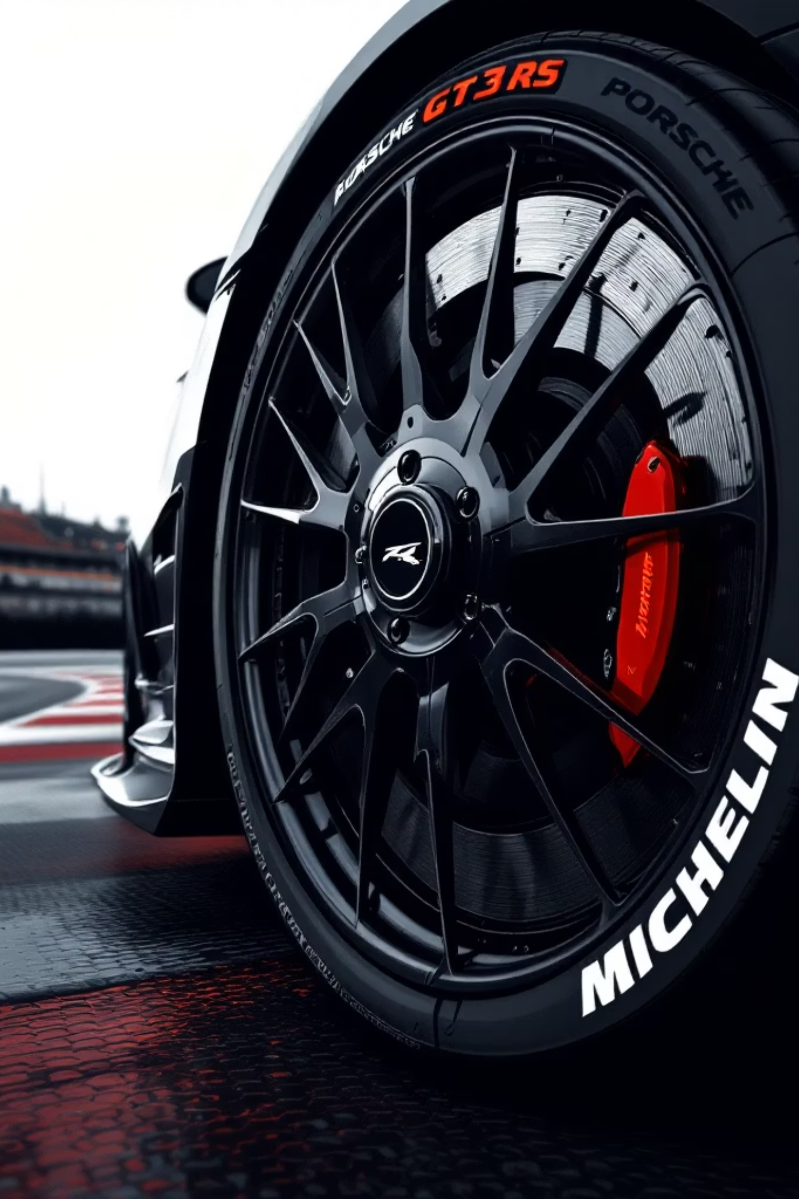
Braking & Wheels: Grip Meets Control
Brakes
Tires
Wheels
Aluminum monobloc fixed‑caliper brakes with 380 mm steel rotors front & rear (option for carbon‑ceramic). Consistent fade resistance.
Michelin Pilot Sport Cup 2 R — 265/35 ZR20 front and 325/30 ZR21 rear for maximum mechanical grip.
20” front / 21” rear forged wheels to reduce unsprung mass and improve steering response.

Slide 7
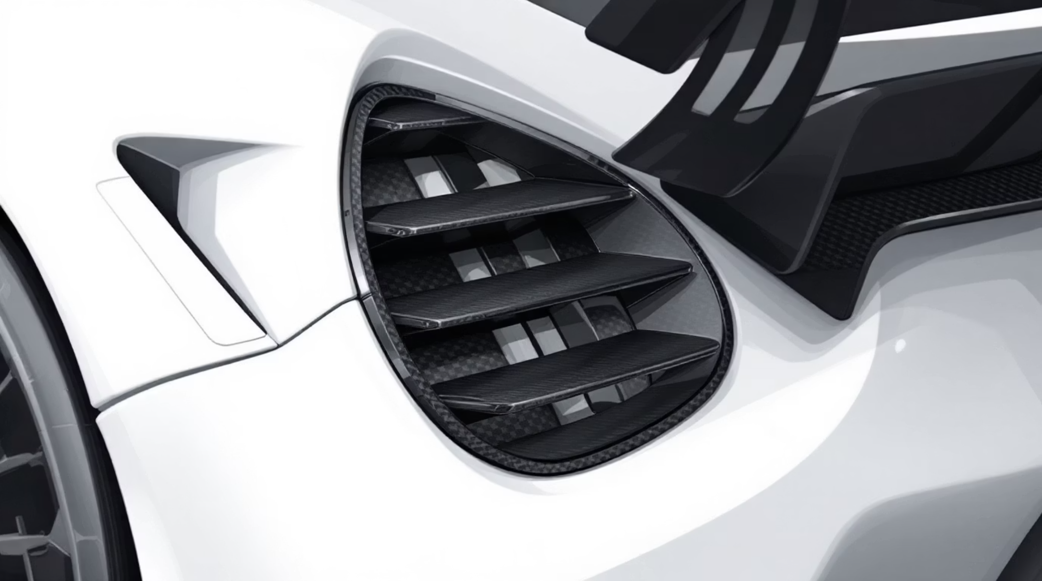
Dimensions & Design
Design Cues: Large vents, fender louvers, and motorsport‑inspired aero from Porsche racing heritage, all functional elements.
Exterior: Length 178.9 in | Width 74 in | Height 50.8 in — wide, low stance for aero and stability.
Wheelbase: 96.7 in — tuned for balanced high‑speed stability and cornering agility.

Slide 8
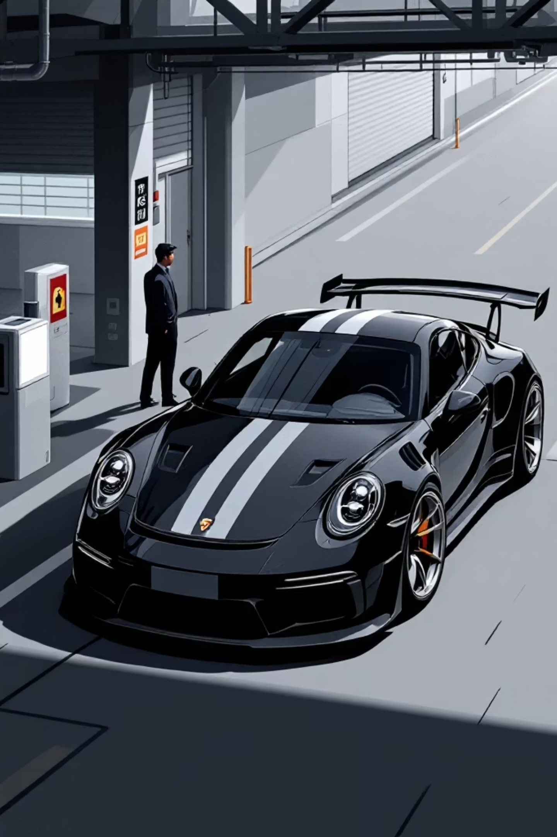
Fuel Efficiency & Practicality
Range & Tank
Fuel tank capacity: 16.9 gallons — sized for spirited driving and track sessions between refuels.
Economy
Combined estimate: ~16 mpg (14 city / 20 highway). High‑revving engine prioritizes performance over efficiency.
Practical Notes
Front luggage space ~4.06 cu ft — minimal but usable for short trips or race gear.

Slide 9

Price & Availability
MSRP: Starting around $223,800 (2023 model). True ownership cost varies with options, taxes, and destination fees.
Market: Available through select Porsche dealers worldwide. High demand and limited allocations can affect delivery timelines and dealer pricing.
Ownership Tip: Order personalization and performance options at purchase — aftermarket modifications can affect warranty and resale.

Slide 10

The Porsche 911 GT3 RS Experience
The GT3 RS is a symphony of engineering: high‑revving power, precision chassis, extreme aerodynamics and race‑grade hardware packaged for road use. For enthusiasts seeking authentic track performance delivered through a usable road car, it’s the ultimate expression of Porsche’s motorsport DNA.
Who it's for
What to expect
Drivers prioritizing lap time, tactile feedback, and pure driving engagement.
Intense performance, limited practicality, and exceptional cachet among collectors and racers.

